Slide 1

Python programming and data visualization for beginners Dr Joel Martin

Slide 2
Week 2
Interpreted language
Parser – tokens – lexical analyszer
Structure of a program – logical lines
Imports, the standard library, and third-party libraries
Python’s import statement
The standard library
Useful / common libraries
random, os, glob, datetime, sys, re, math, statistics, csv, json
Third-party libraries
PyPI
numpy, pandas, matplotlib
Notes:
Arithmetic operators.
Assignment operators.
Comparison operators.
Logical operators.
Identity operators.
Membership operators.
Bitwise operators.

Slide 3
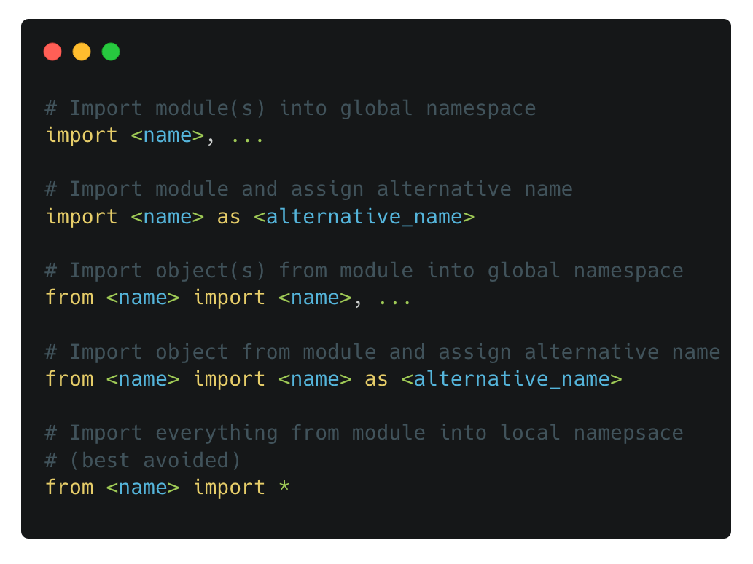
Importing libraries
import
Python code is organized into modules
To access functionality from another module, we must import the module using the import statement
By convention, imports happen at the top of a script
Right: different ways of using the import statement

Slide 4
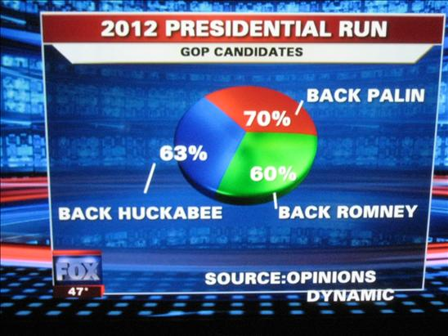
Misleading charts
What is wrong with this chart?

Slide 5
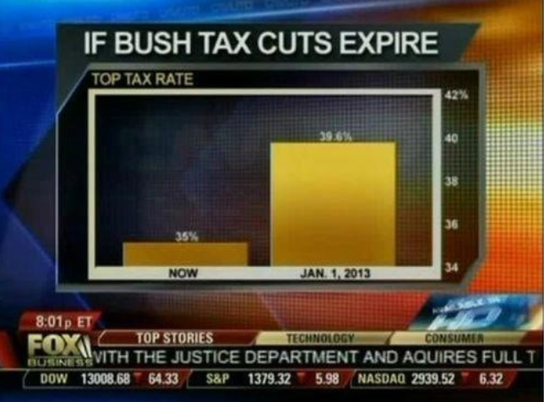
Misleading charts
What is wrong with this chart?

Slide 6
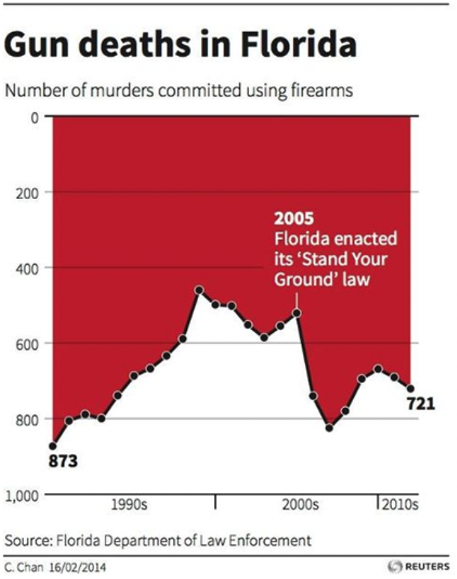
Misleading charts
What is wrong with this chart?

Slide 7
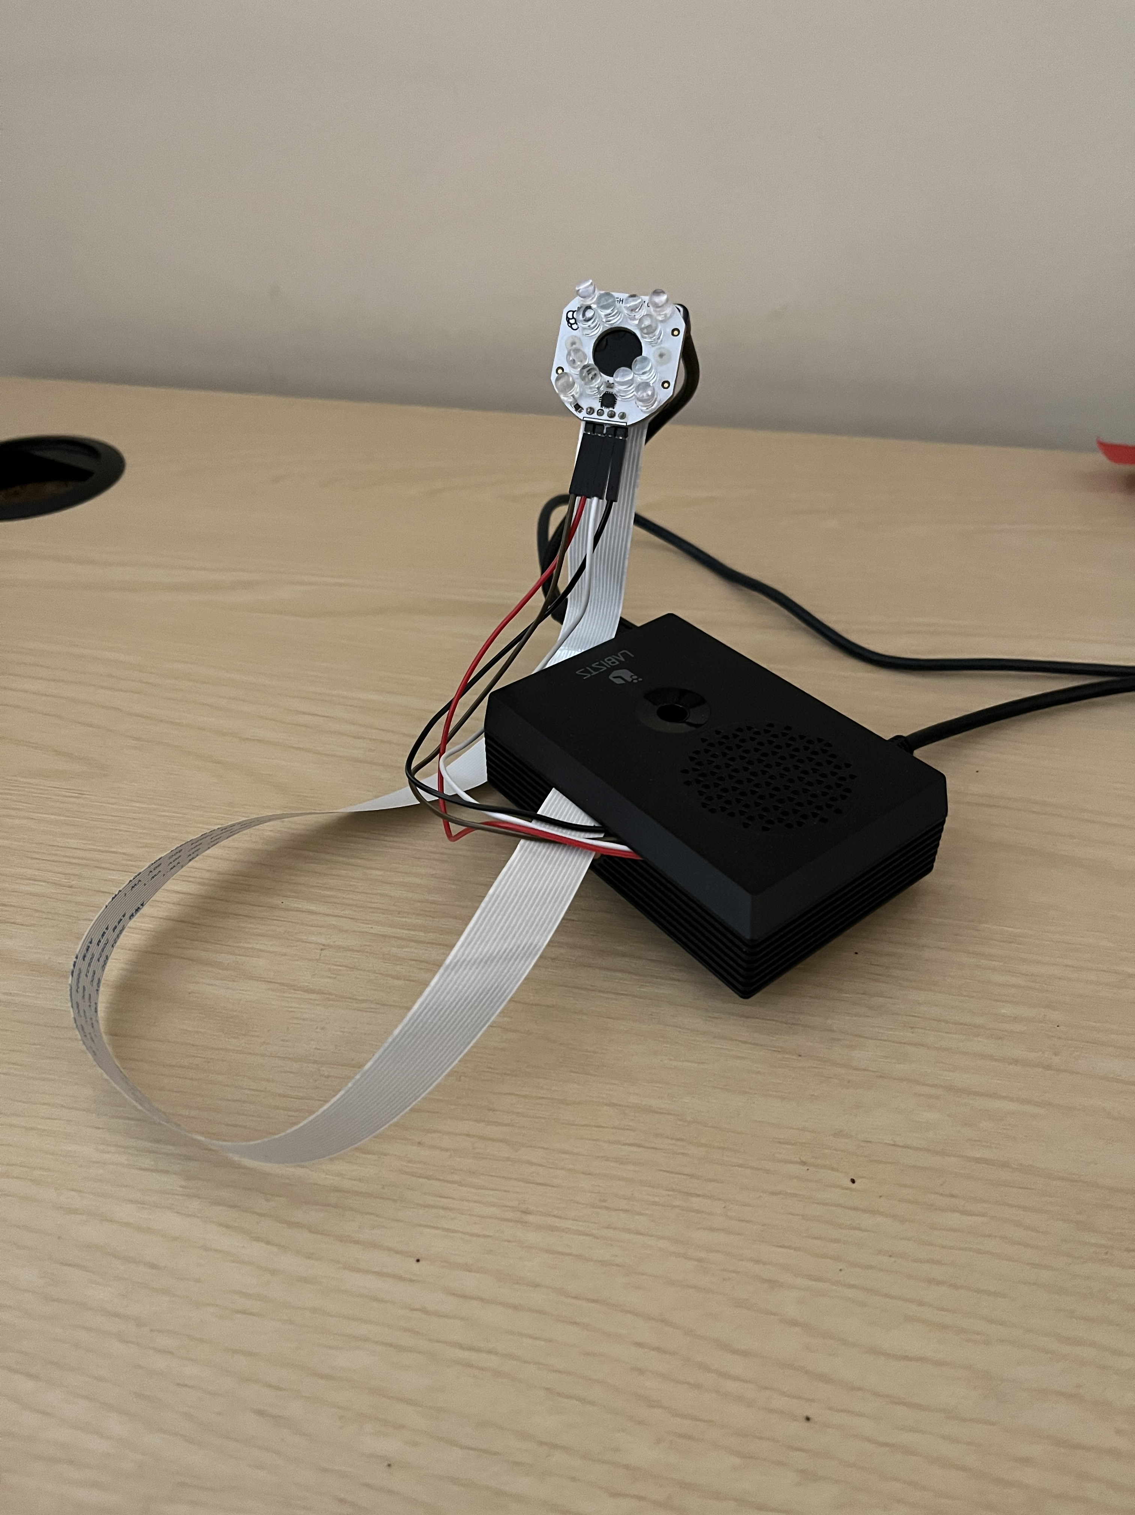
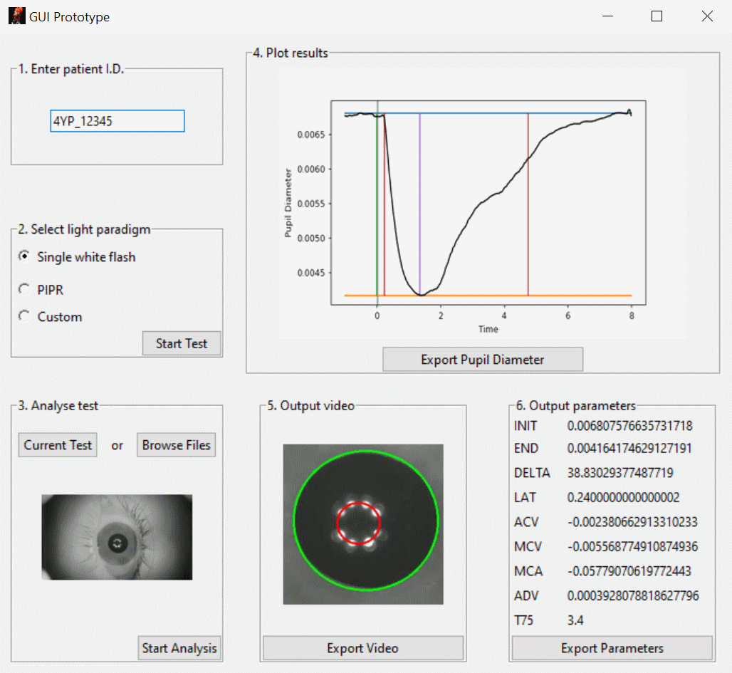
Example projects
Automated pupillometer

Slide 8
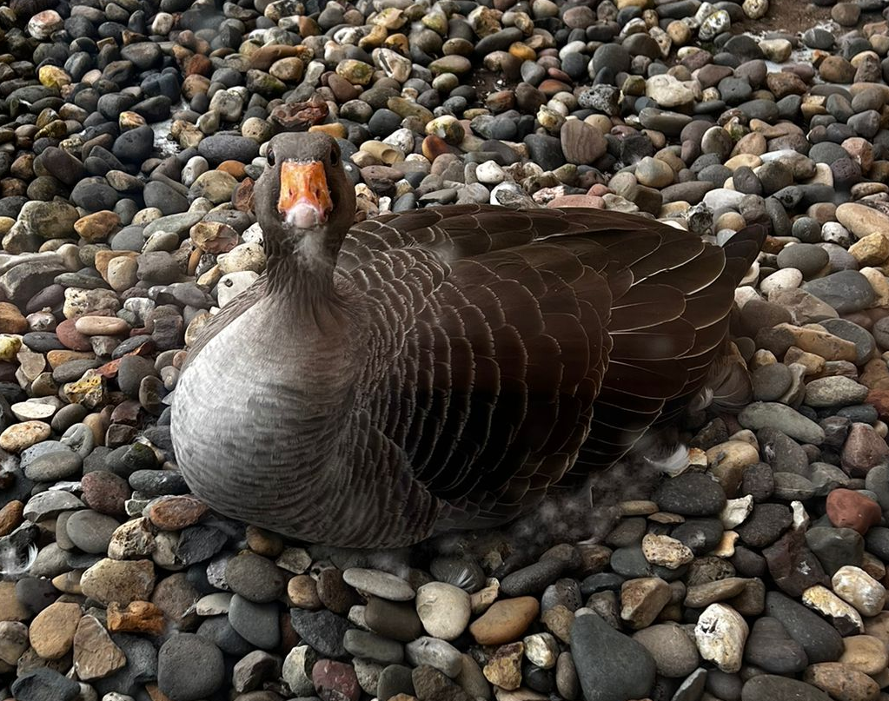
Example projects
Automated pupillometer
Or GooseCam

Slide 9
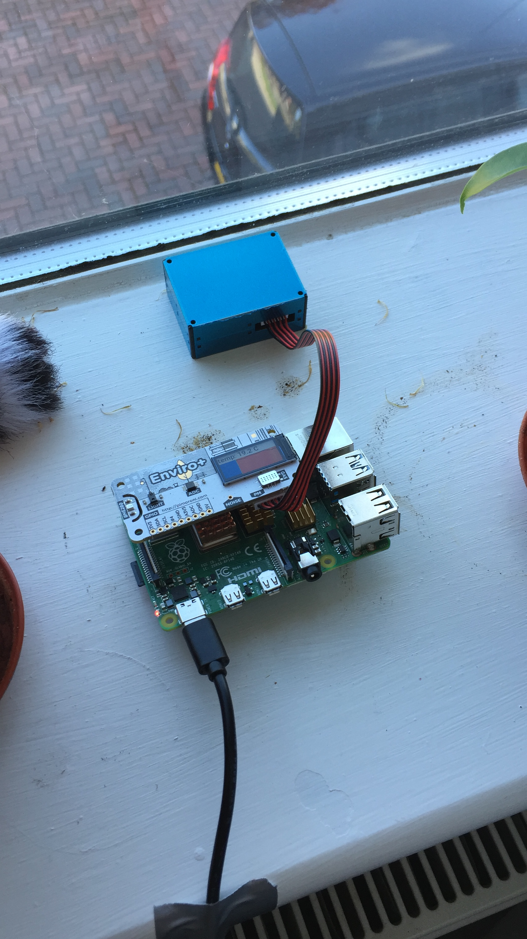
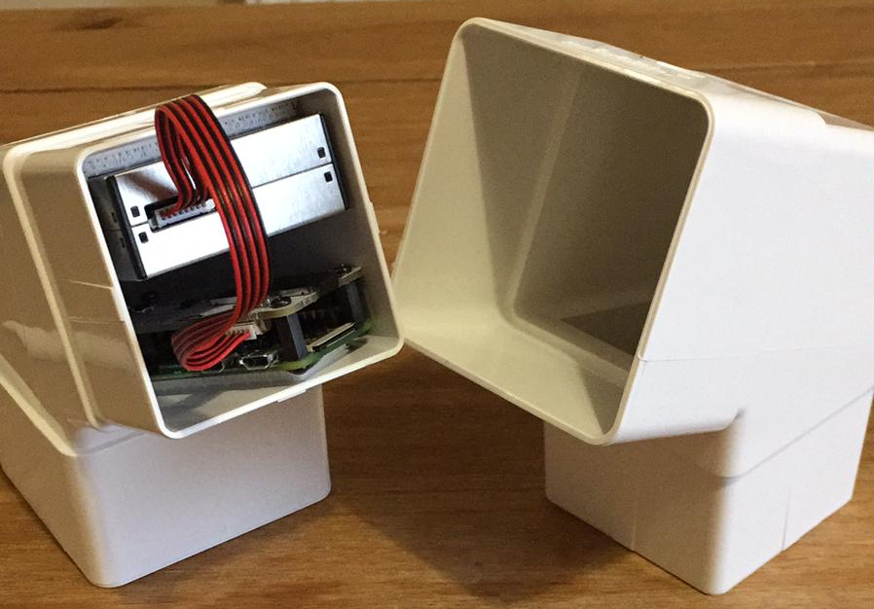
Example projects
Environmental sensor
Temperature
Humidity
Pressure
Light levels
Noise
Particulate matter
Community science

